Slide 1
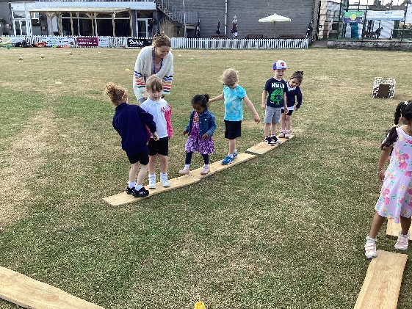
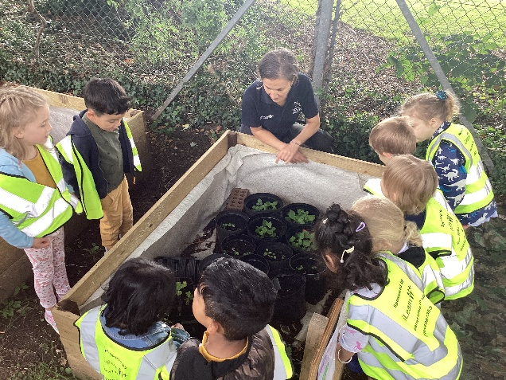
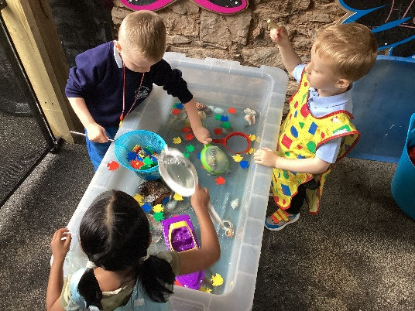
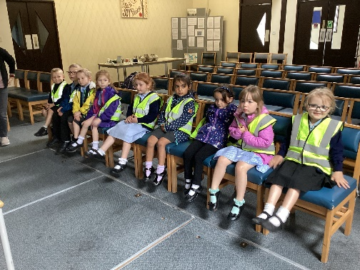
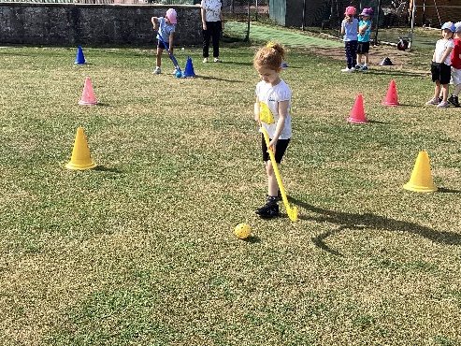
Parents Welcome Meeting 2023

Slide 2
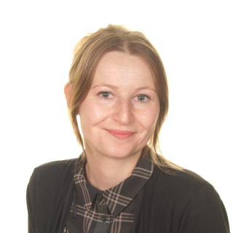
EYFS Staff
Mrs Kelly Yeo
EYFS & KS1 Lead
Phonics & Early Reading Lead
PE Lead
PSHE Lead
Mrs Barbara Sutton
HLTA
Miss Tara Ashton
Preschool Leader

Slide 3
The purpose of our meeting is :
To help you to understand the curriculum we will be teaching in the reception class
To understand the different ways in which we teach and your child will learn
To identify the key ways in which you can help your child at home and in school
Notes:
Parent partnership is key, a two way flow of information is essential
Every child deserves the best possible start in life and the support that enables them to fulfil their potential. Children develop quickly in the early years and a child’s experiences between birth and age five have a major impact on their future life chances. A secure, safe and happy childhood is important in its own right. Good parenting and high quality early learning together provide the foundation children need to make the most of their abilities and talents as they grow up.

Slide 4
What is the Early Years Foundation Stage?
The Early Years Foundation Stage (EYFS) is the stage of education for children from birth to the end of the Reception year
It is based on the recognition that children learn best through play and active learning
It is the same curriculum as in pre-reception settings
Notes:
The curriculum is different

Slide 5
There are seven areas of learning and development:
Prime areas
Communication and Language
Personal Social and Emotional development
Physical Development
Specific Areas
Literacy
Mathematics
Understanding the World
Expressive Arts and Design
There are 17 Early Learning Goals against which each child is assessed at the end of the reception year
Notes:
All areas of learning and development are important and inter-connected.
The prime areas are important for building the foundations, it is through the specific areas that the primes are strengthened

Slide 6
There are also three characteristics of effective teaching and learning
Playing and exploring
Active learning
Creating and thinking critically
These tell us about how each child learns not what they are learning
Notes:
We look for things such as what engages or motivates a child, problem solving, resilience, changing strategy etc.

Slide 7
Play in the Early Years
Play is essential for children’s development, building their confidence as they learn to explore, relate to others, set their own goals and solve problems. Children learn by leading their own play, and by taking part in play which is guided by adults.
Notes:
Yes, children will still be playing in reception, but we will plan high quality learning experiences, a well-planned environment and have skilful adults who support that learning.
There will also be times when children are

Slide 8
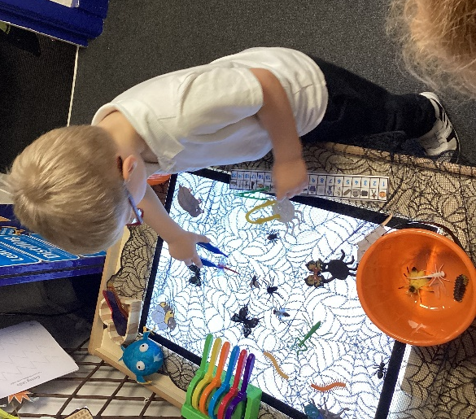
All this learning takes place… Indoors and Outdoors No matter what the weather!

Slide 9
EYFS Framework
The curriculum gives us the opportunity to spend more time interacting and playing with the children
This means that we will not be completing many written observations and putting them on Tapestry
This does mean that we will know your children very well and be able to share observations verbally with you
Notes:
If you as a parent have been used to an online system in your child’s pre-reception setting you will probably have had new observations etc. uploaded very regularly. In order to be with the children to play, learn, interact, question etc. we won’t be able to replicate this. Examples of really significant learning will be shared in this way, all other information will be shared through our conversations with you. It means we will know your children very well.
Partnership working Conversation with parents – inform parents not to expect as much ...practitioner’s time is with children ..will support the two way flow but parents might be the major contributor

Slide 10
Developing children’s language and vocabulary
There is a huge focus on early language and extending vocabulary.
We will do this by:
Having quality learning conversations and interactions with the children
Reading a range of stories, poems, rhymes and non-fiction texts
Teaching new words and vocabulary
Sharing what we are doing with you
Notes:
There is a new focus on early language and extending vocabulary, with more examples on how to embed and develop vocabulary skills across all 7 areas, because this improves child development in a broad curriculum

Slide 11
What can you do to help your child?
Chat, play and read to and with them
Encourage them to be independent
Play board games with them
Notes:
It is important for parents and early years settings to have strong and respectful relationships
This includes listening regularly to parents and giving parents clear information about their children’s progress
The help that they give their children at home has a very significant impact on their learning

Slide 12
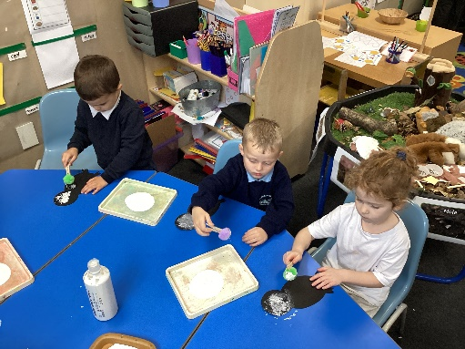
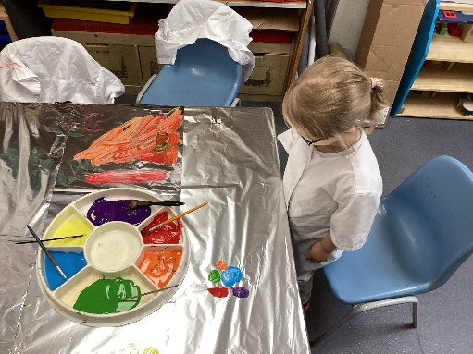
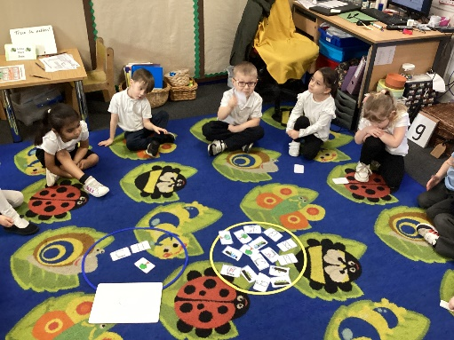
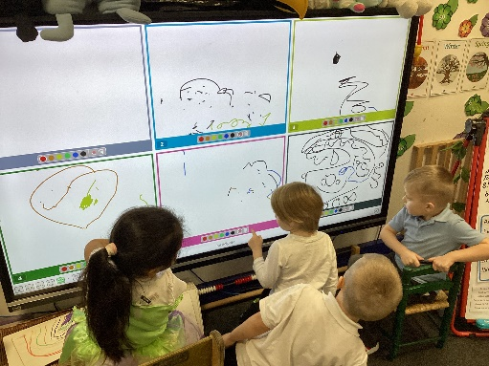
A typical day in Reception
8.40 doors open – early morning tasks
8.50 Registration
9.00- 10.15
Phonics, Continuous Provision, Focus tasks
10.30 Break
10.45 – 12.15
Maths, Continuous Provision, Focus tasks, Literacy
12.15 Lunch
1.15 Registration
1.20 Topic/ RE/ PE/ EAD
1.40 Continuous Provision & Focus tasks
3.00 Story Time
3.15 Home time

Slide 13
Parents as Partners
We have termly parent meetings and provide additional meetings when required
We discuss your child’s learning, progress and next steps
We run parent workshops and encourage all to attend where possible
We expect all parents to add photos and videos to Tapestry to help build their learning Journal

Slide 14
Healthy School
School dinners are free for children in Reception and KS1 – please order through parent pay.
We give the children fruit, breadsticks water/ milk every snack time.
Children need to bring in a named water bottle from home every day
Daily toothbrushing

Slide 15
Thank you for coming!
Please see me if you need any other information.
Mrs Yeo

Slide 16
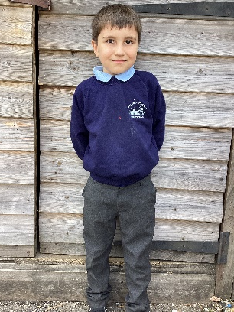
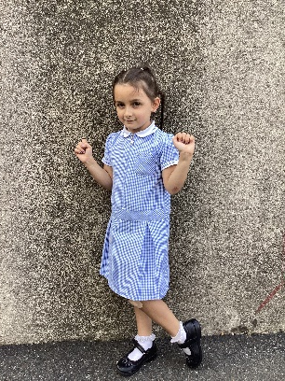
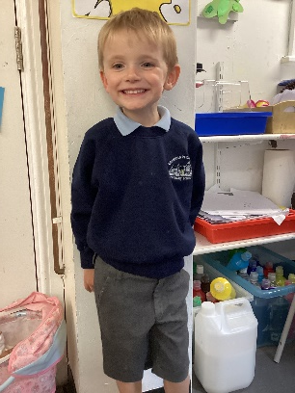
School Uniform
Pale blue polo shirt
Grey trousers/shorts or a skirt/pinafore dress Navy cardigan or jumper
A pale blue checked dress or grey shorts (optional in summer)
White, grey or navy socks, tights and hairbands
Second hand uniform:
We do have a selection of second hand uniform in the office. Please pop in and see what we have.
Sweatshirts: from £10.00 Cardigans: from £11.50 Full zip fleece: from £14.00 PE Bags: £5.00 Book Bags: £4.75
These can be ordered through the office, and paid for on Parentpay.

Slide 17
PE Kit
White t-shirt, navy or black shorts and trainers.
Breakfast Club
Our Breakfast Club is open from 07:45am each day. We offer a range of cereals, bagels, toast and juice for all the children. The doors close at 08:15am. The charge for this is only £0.50 per day. Do come along and try it.
Parentpay
We are now using Parentpay for our school meal ordering/paying and for trips and uniform - watch this space! If your child is currently in preschool, you should all have received your log-in details and can link more than one child to your account. If you are new to the school you will have the details given to you in September.
Please contact us if you have any problems.

Slide 18
Bookbags

Slide 19
Lateness and Absence
Bearnes Primary School will not authorise any holidays during term time.
You could incur a fine from the Local Authority
We aim for 97%

Slide 20
What Next…
Complete all paperwork before the end of term
Start date Wednesday 6th September at 8.40

